Slide 1
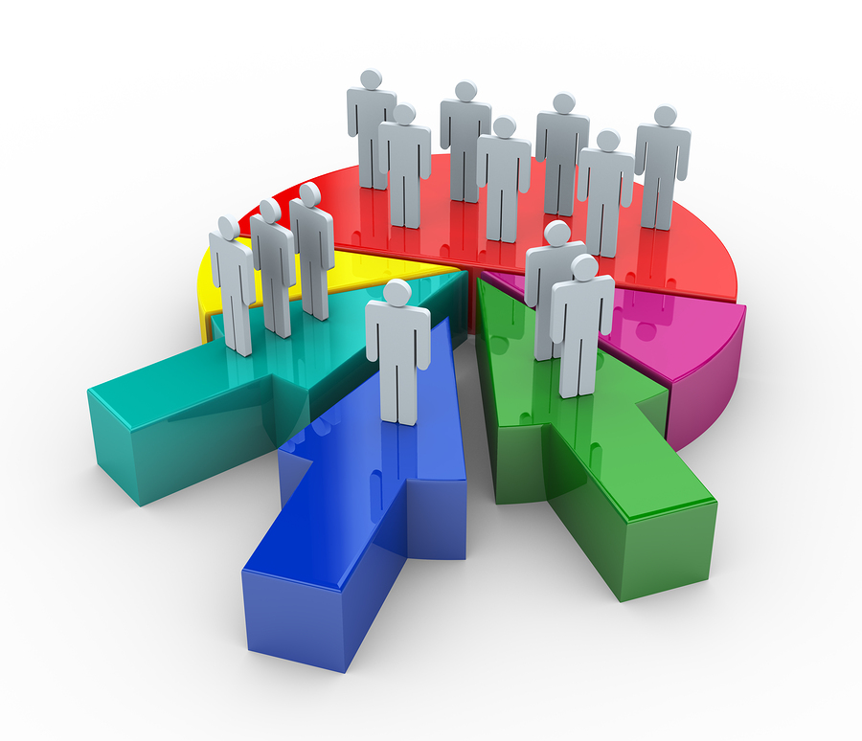
Customer Segmentation using Machine Learning Identifying Profit Enhancement Opportunities
Project 4
Contributors:
Ahmed Dahham
Uma Yeruva
Samantha Brown
Julia Lira

Slide 2
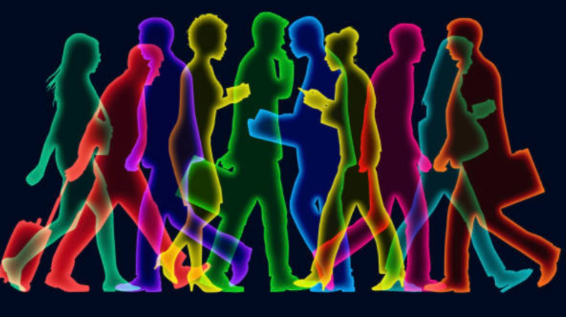
Introduction: Virtual shopping / Digital Marketing may first come to mind when you hear Machine Learning and algorithms. For this reason, we found the following project on customer segmentation in physical shopping malls an interesting opportunity to see unsupervised learning in use. Goal: To identify target mall customers based on available data. Increase sales and create more efficient facilities.

Slide 3
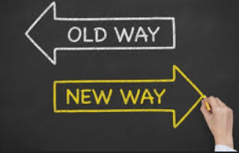
The Challenge
- Rapid rise of online / mobile shopping
- Change in customer behavior: Experiences vs Ownership
- Not all malls are created equal
- No / limited toolset to compete with online competition

Slide 4
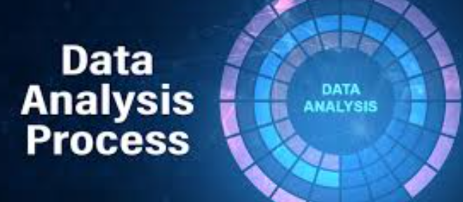
How Machine Learning can Help
Customer segmentation is the method of distributing a customer base into collections of people based on mutual characteristics.
Data collected can help determine solutions such as:
- Operational Efficiency
- Layout / Signage Optimization
- Create more personalized Marketing
- Security and Surveillance
The provided dataset for this project includes 200 observations:
Mall_Customers.csv
1. Preprocessing
2. Choosing the right K-Model
3. Naming and plotting clustering results
4. Possible Growth Strategies Summary

Slide 5
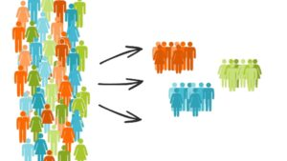
THE DATA
- Unique ID given to a customer
- Gender of the customer
- Age of the customer
- Annual income of the customer
- Spending Score ( The score - out of 100 - given by mall authorities based on spending and behavior of the customer )

Slide 6
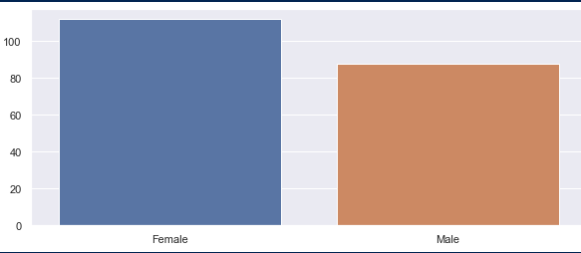
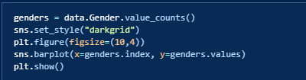
PREPROCESSING Gender

Slide 7
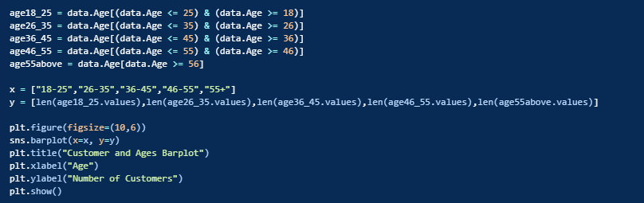
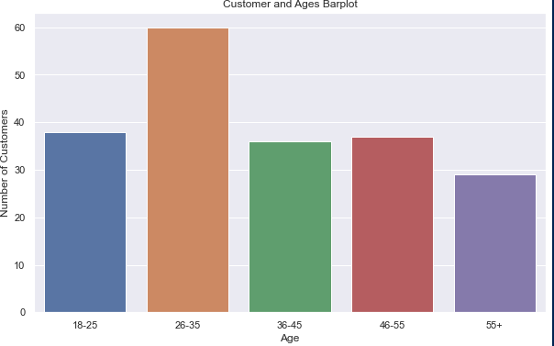
Customer Age

Slide 8
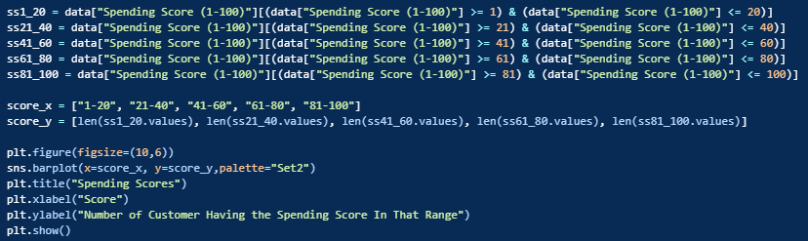
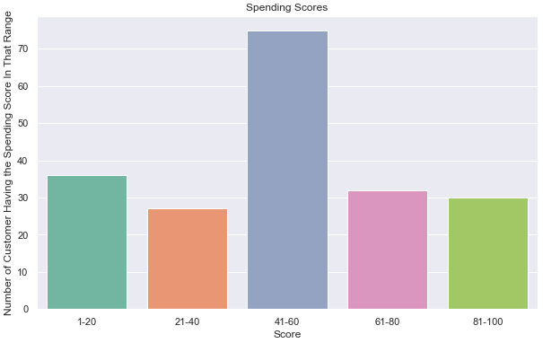
Spending Scores

Slide 9
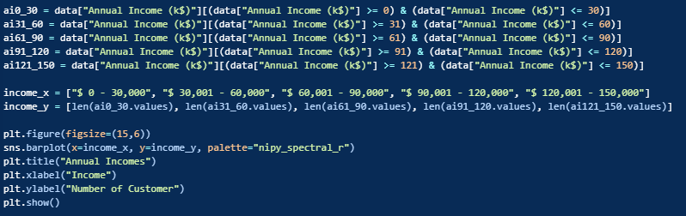
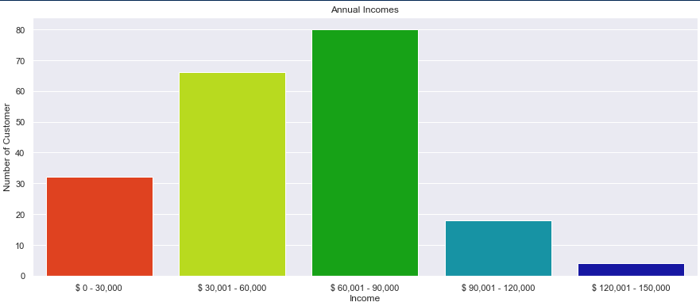
Annual Income

Slide 10
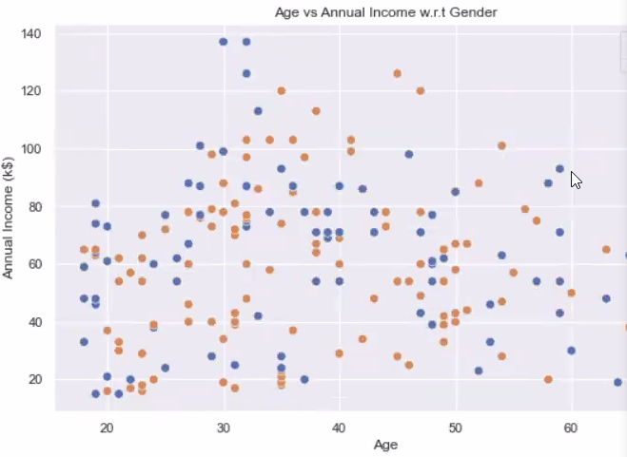
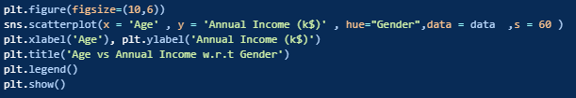
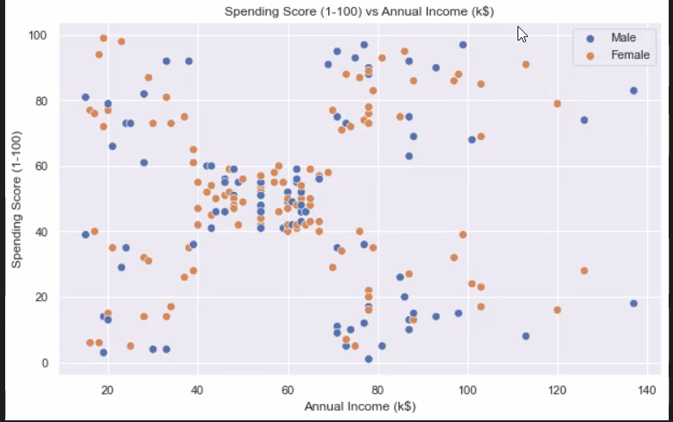
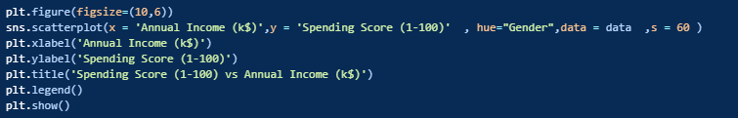
Correlation

Slide 11
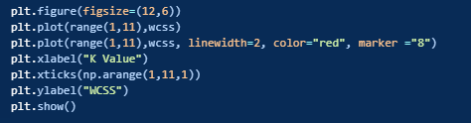

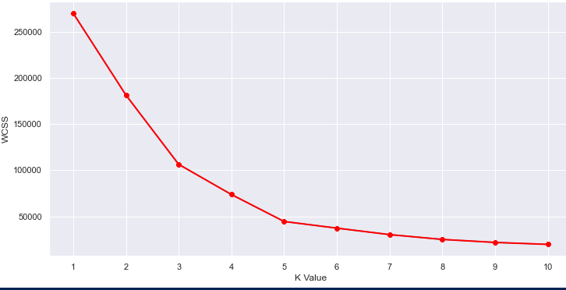
K-Means and the Elbow Method

Slide 12
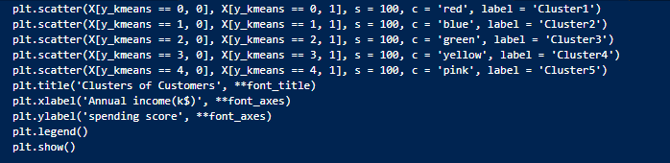
Plot the Clusters:
Cluster 1 High Income & High Spending - customer satisfaction reached
Cluster 2 Low Income & High Spending
Cluster 3 High Income & Low Spending ( area of opportunity )
Cluster 4 Low Income & Low Spending
Cluster 5 Average Income & Average Spending ( area of opportunity )

Slide 13
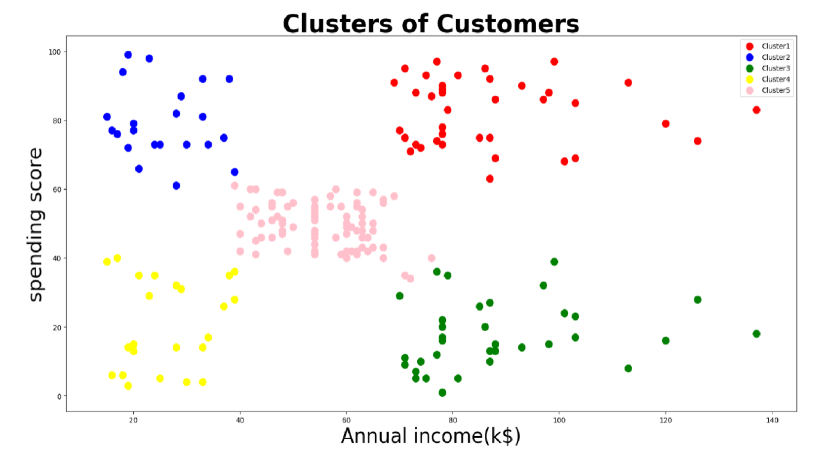
Spending Score
VS
Annual Income
Conclusion: To optimize profits for the mall, focus should be on clusters 3 & 5.
- Cluster 3 ( High Income , low spending)
- Cluster 5 ( Average Income, average spending)

Slide 14
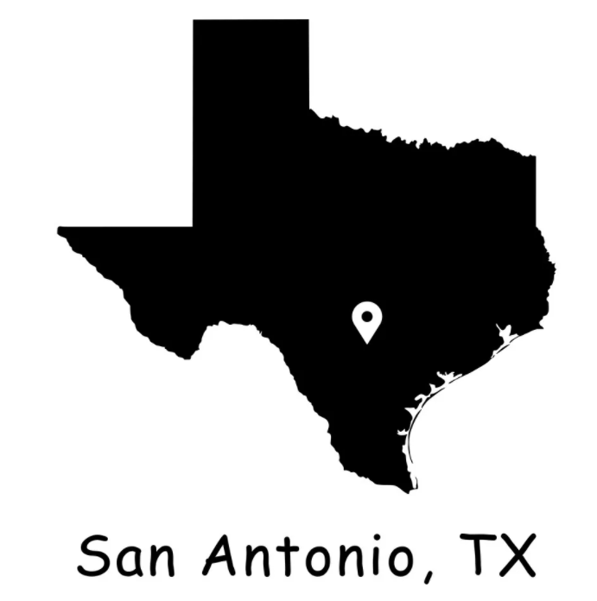
Local perspective - Mall Memories
The data we reviewed was non-specific - the locations are unknown .
While we do not have data to determine if following malls utilized unsupervised machine learning, these local malls represent examples of latest trends in malls. Evolving from spaces for shopping transactions to “customer experience destinations.”
North Start Mall – Visibility on 410 / airport traffic
Fully Enclosed
River Center Mall – access to river, target is clearly tourist. In addition to River Walk, Aquarium and LegoLand
Park North Shopping Center – Comedy Club, Unique Movie theater experience
The Shops at La Cantera - open air, close to amusement park, UTSA
Wonderland Mall – Convention/ Events
Rolling Oaks Mall - University location

